Slide 1
Object Oriented Programming C++ Class and Member Functions
CS(217) Object Oriented Programming
Abeeda Akram

Slide 2
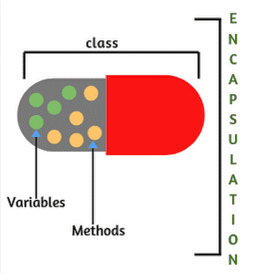

Object Oriented Programming
Implementation of Abstract Data Type (ADT)
Select a concrete data representation using built-in data types
Implement all relevant functions
C++ Class (class is reserve word in C++)
Class is used to only define new data types.
It is collection of
Data called data members or attributes
Functions called member functions, methods or behaviors

Slide 3

Class Member access specifiers
class Point
{
private:
int x;
int y;
};
private:(reserve word in C++)
Class members accessible only to member functions of class
Not accessible outside class
public:(reserve word in C++)
Class members accessible to member functions of class
Also accessible outside class
protected:(reserve word in C++)
Class members Accessible to member functions and derived classes (will use and discuss later on)
By default class member access is private, if no access specifier is mentioned
class Point
{
public:
int x;
int y;
};
class Point
{
int x;
int y;
};

Slide 4


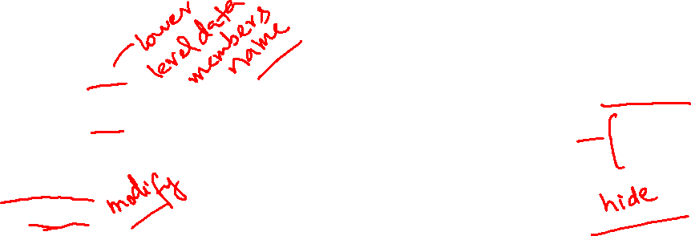
Where is Object Encapsulation?
Information (Data) and implementation hiding
void main(){
Point p;
cout << p.x;
//object variable name dot member name
cout << p.y;
//object variable name dot member name
p.x = 100;
cin>>p.y;
//initialize members
}
X
y
?
class Point
{
public:
int x;
int y;
};
?

Slide 5

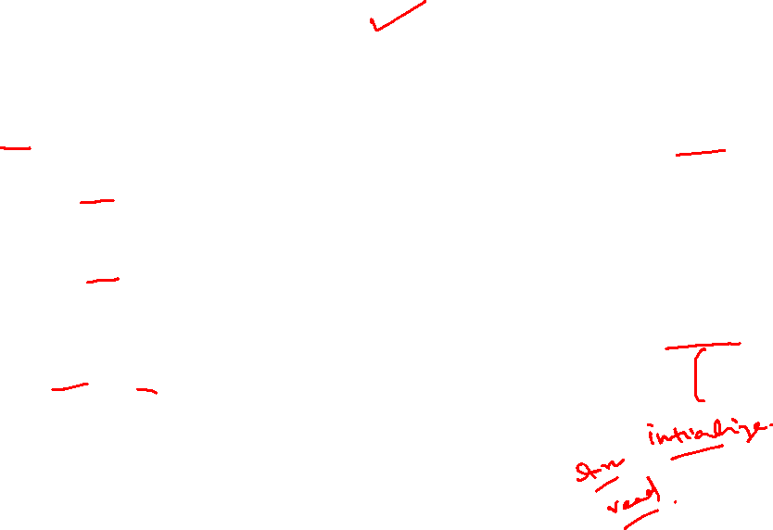
Object Encapsulation
Information (Data) and implementation hiding
X
y
class Point
{
int x;
int y;
};
void main(){
Point p;
cout << p.x;
//Compiler Error cannot access private member outside
cout << p.y;
//Compiler Error cannot access private member outside
p.x = 100; cin>>p.y;
//Compiler Error cannot access private member outside
}
?
?
class Point
{
private:
int x;
int y;
};
How to store and process the data of objects

Slide 6
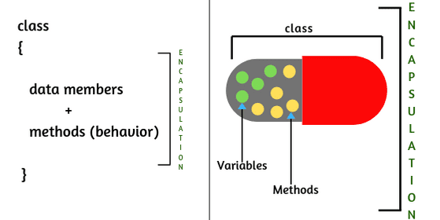
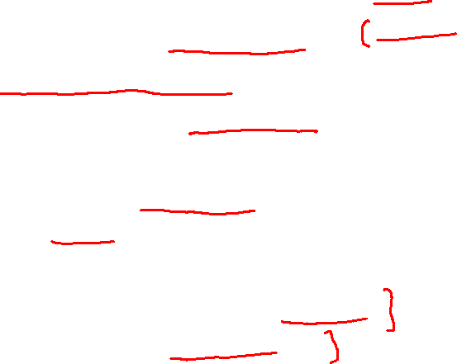
Class Member Functions
Provide Information hiding and safe processing
Can directly access all other members of class
Data members / no need to pass in parameters
Implement all member functions before use
For all member functions only one copy is created at class level
That copy is used by all objects.
Member access specifier can be public or private
Should be public to access and call them from outside.
Should be private to make some hidden functions.

Slide 7
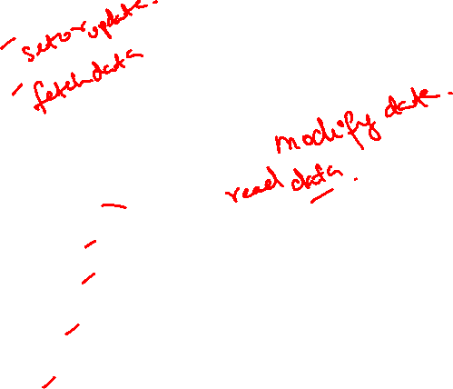
Class Member Functions (TYPES)
Setters
Getters
Mutators or Transformers
Accessors or Observers
Constructors
Destructors
Operators
Iterators

Slide 8
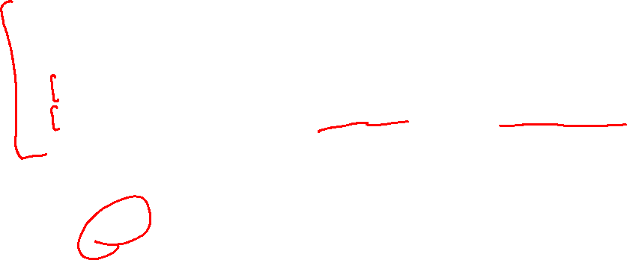
C++ Class
class class-name
{
//declaration statements here
//data members defined only not initialized
//add member functions prototype or complete implementation
};
class myTime
{
int sec;
int min;
int hour;
};
class myDate
{
int day;
int month;
int year;
};
class Student
{
int rollNum;
int courses;
float marks;
char name[20];
};
class Point
{
int x;
int y;
};

Slide 9
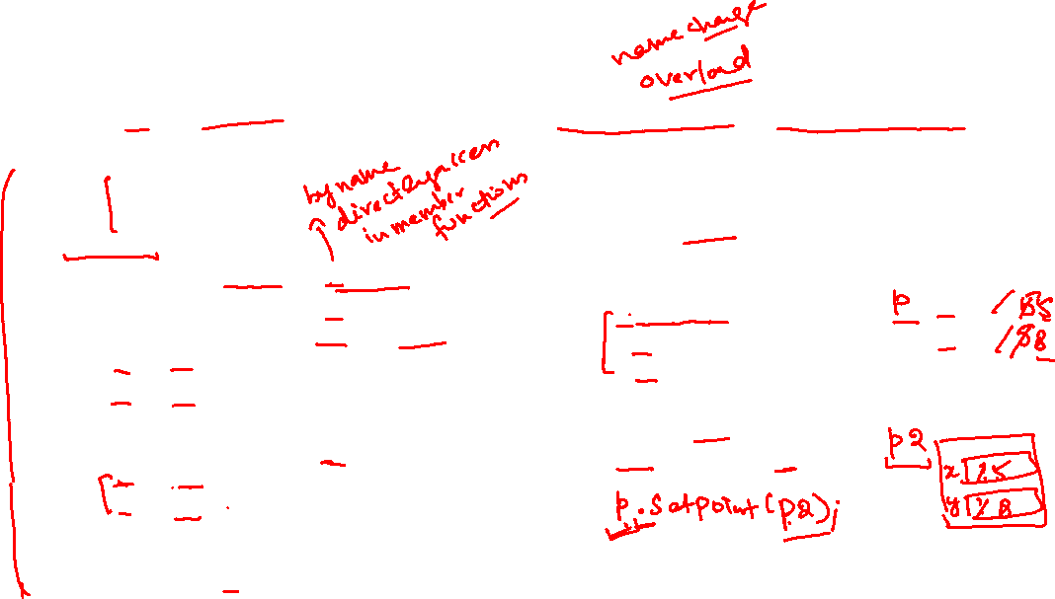
Member functions (Setters)
Used to set or update values of individual data members or complete Object
class Point {
int x;
int y;
public:
void setX(int xi){ x = xi;}
void setY(int yi){ y = yi;}
void setPoint(int xi, int yi){
x = xi;
y = yi;
}
void setPoint(Point p){
x = p.x;
y = p.y;
}
//add member functions complete implementation
};
void main(){
Point p;
//Objects created but not initialized
p.setX(5);
p.setY(5);
p.setPoint(5,8);
Point p2;
p2.setPoint(p);
}
X
y
?
?

Slide 10
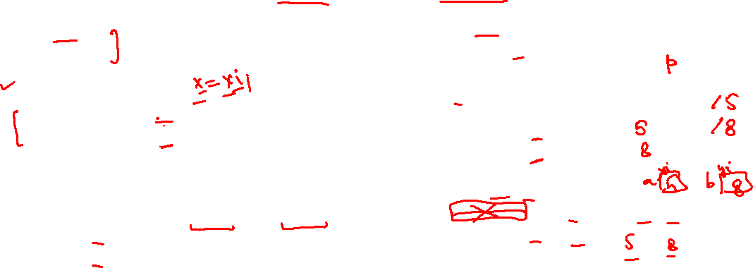
Member functions (Getters)
Used to fetch values of individual data members or complete Object
class Point {
int x;
int y;
public:
//setters
void setX(int xi){ x = xi;}
void setY(int yi){ y = yi;}
//getters
int getX(){ return x;}
int getY(){ return Y;}
void getPoint(int & xi, int & yi){
xi = x;
yi = y;
}
//add member functions complete implementation
};
void main(){
Point p;
p.setPoint(5,8);
cout << p.getX();
cout << p.getY();
int a, b;
cout << p. getPoint(a, b);
cout << a << b;
}
X
y
?
?

Slide 11
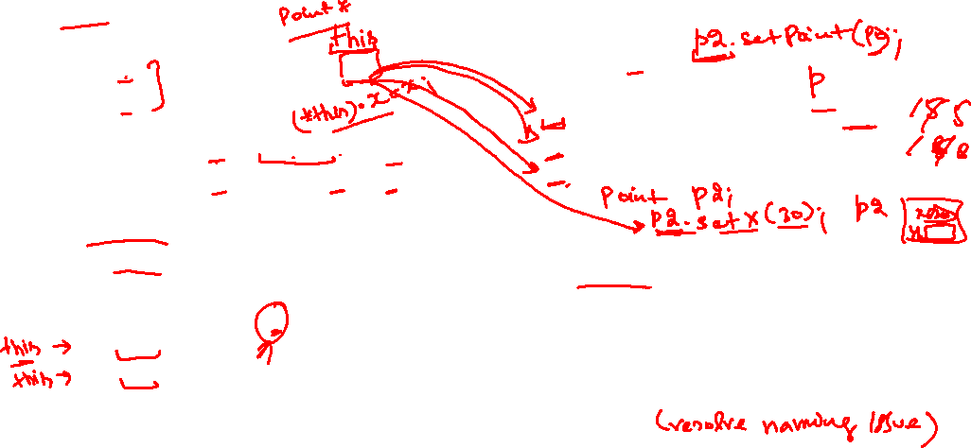
Member functions (Setters and this pointer)
Used to set or update values of individual data members or complete Object
class Point
{
int x;
int y;
public:
void setX(int x){ this->x = x;}
void setY(int y){ this->y = y;}
void setPoint(int x, int y){
this->x = x;
this->y = y;
}
void setPoint(Point p){
x = p.x;
y = p.y;
}
//add member functions complete implementation
};
void main(){
Point p;
p.setX(5);
p.setY(5);
p.setPoint(5,8);
}
X
y
?
?
this is a pointer
Single copy of this pointer is maintained at class level accessible in member functions only.
Used when to keep same member functions parameters name as data members.

Slide 12
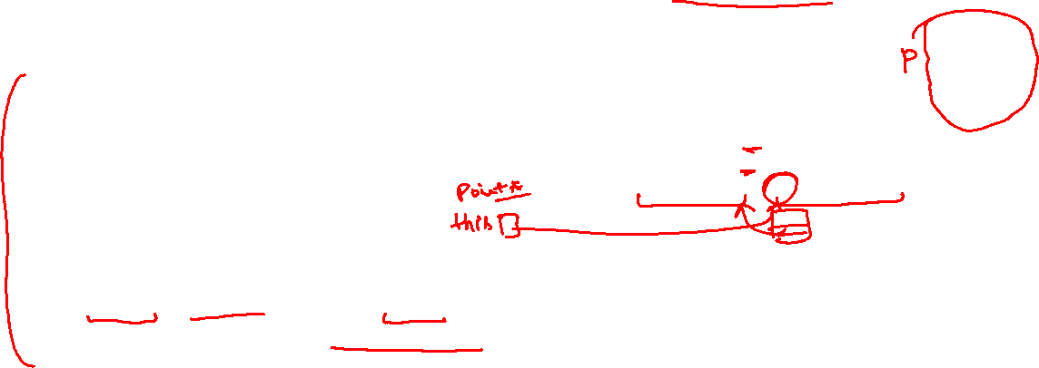
Member functions (Getters and this pointer)
Used to fetch values of individual data members or complete Object
class Point
{
int x;
int y;
public:
//setters
void setX(int xi){ x = xi;}
void setY(int yi){ y = yi;}
//getters
int getX(){ return x;}
int getY(){ return Y;}
Point getPoint(){return *this;}
//add member functions complete implementation
};
void main(){
Point p;
p.setPoint(5,8);
cout << p.getX();
cout << p.getY();
Point p2 = p.getPoint();
}
X
y
5
8
this is a pointer
Single copy of this pointer is maintained at class level accessible in member functions only.
Used when to return complete object from member functions.

Slide 13
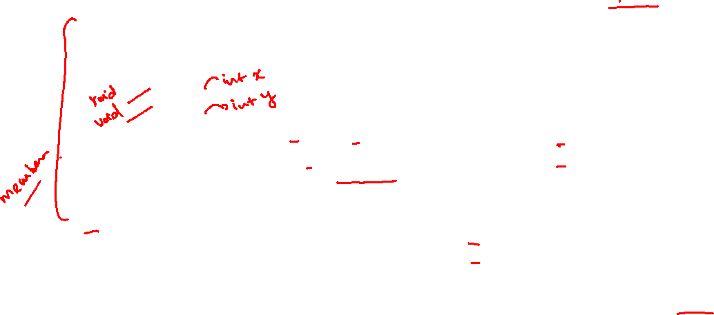
Member functions (Setters)
Implement outside the class
//implement outside class definition
void setX(int x){ this->x = x;}
//Compiler Error undefined variable this
void setY(int y){ this->y = y;}
//Compiler Error undefined variable this
void setPoint(int x, int y){
this->x = x;
this->y = y;
}
//Compiler Error undefined variable this
void setPoint(Point p){
x = p.x;
y = p.y;
}
//How to resolve membership issue?
class Point
{
int x;
int y;
public:
int setX();
int setY();
void setPoint(int x, int y);
void setPoint(Point p);
//add member functions prototype
};

Slide 14

Member functions (Getters)
Implement outside the class
class Point
{
int x;
int y;
public:
int getX();
int getY();
Point getPoint();
//add member functions prototype
};
//implement outside class definition
int getX(){ return x;}
//Compiler Error undefined variable x
int getY(){ return Y;}
//Compiler Error undefined variable Y
Point getPoint(){return *this;}
//Compiler Error undefined variable this
//How to resolve membership issue?

Slide 15
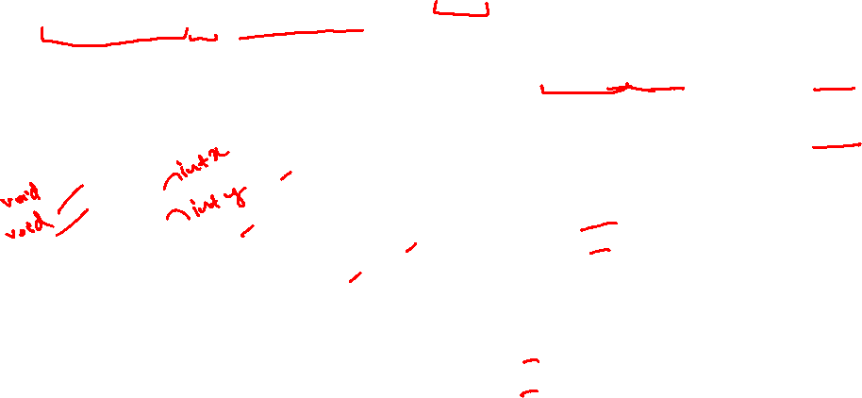
Class Members Scope resolution
Use Scope resolution operator (::)
Class name :: class member name
class Point
{
int x;
int y;
public:
int setX();
int setY();
void setPoint(int x, int y);
void setPoint(Point p);
//add member functions prototype
};
//implement outside class definition
void Point:: setX(int x){ this->x = x;}
void Point:: setY(int y){ this->y = y;}
void Point:: setPoint(int x, int y){
this->x = x;
this->y = y;
}
void Point:: setPoint(Point p){
x = p.x;
y = p.y;
}

Slide 16

Class Members Scope resolution
Use Scope resolution operator (::)
Class name :: class member name
class Point
{
int x;
int y;
public:
int getX();
int getY();
Point getPoint();
//add member functions prototype
};
//implement outside class definition
int Point::getX(){ return x;}
int Point::getY(){ return y;}
Point Point::getPoint(){
return *this;
}

Slide 17
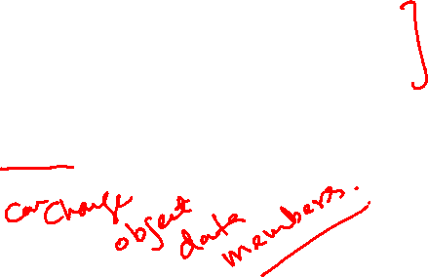
Member functions (Mutators)
Mutator functions can
read data members
write into class data members
Example:
Setters are also Mutators

Slide 18
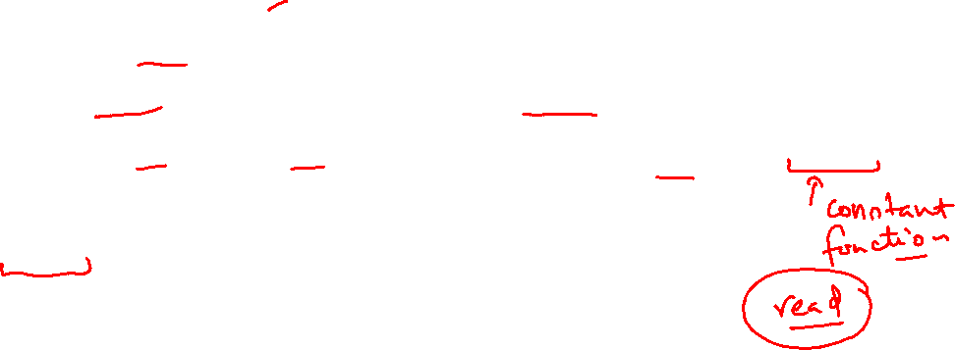
Member functions (Accessors)
Accessor functions can only
read data members
Cannot write into class data members
Constant functions are used to make accessors
returntype functionName (parameters list) const;
Example:
Getters should be accessors as they only read data

Slide 19
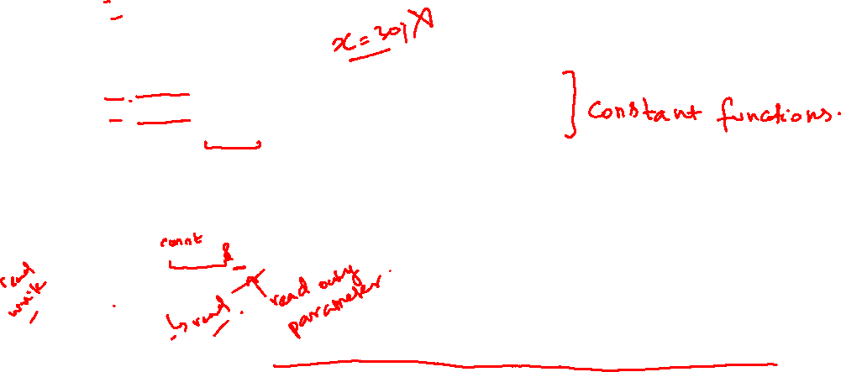
Member functions (Mutators and Accessors)
class Point
{
int x;
int y;
public:
//getters
int getX() const { return x;} //Accessor
int getY() const { return Y;} //Accessor
Point getPoint() const {return *this;} //Accessor
//setters
void setX(int x){ this->x = x;} //Mutator
void setY(int y){ this->y = y;} //Mutator
void setPoint(int x, int y){ this->x = x; this->y = y;} //Mutator
void setPoint(Point p){//Mutator
this->x = p.x;
this->y = p.y;
}
//add member functions complete implementation inside class definition
};

Slide 20

Member functions (Setters and Getters)
class Point
{
int x;
int y;
public:
//getters
int getX() const; //Accessor
int getY() const; //Accessor
Point getPoint() const; //Accessor
//setters
void setX(int x); //Mutator
void setY(int y); //Mutator
void setPoint(int x, int y); //Mutator
void setPoint(Point p); //Mutator
//add member functions Prototype inside class definition
};

Slide 21
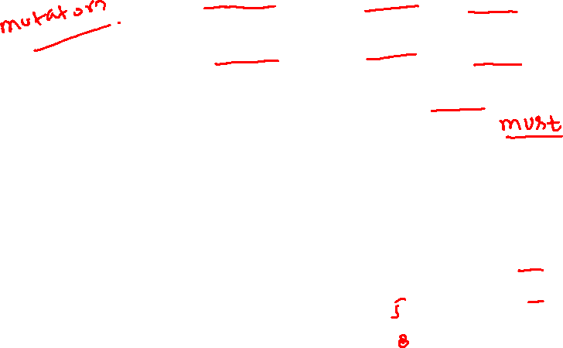
Member functions (Mutators and Accessors)
//implement outside class definition
void Point::setX(int x){
this->x = x;
}
void Point::setY(int y){
this->y = y;
}
void Point::setPoint(int x, int y){
this->x = x;
this->y = y;
}
void Point::setPoint(Point p){
x = p.x;
y = p.y;
}
int Point::getX() const { return x;}
int Point::getY() const { return y;}
Point Point::getPoint() const
{
return *this;
}
void main(){
Point p;
p.setPoint(5,8);
cout << p.getX();
cout << p.getY();
}
X
y
5
8

Slide 22
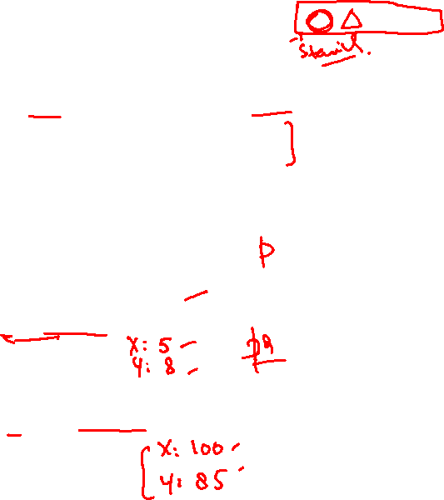
Member functions (Other functions)
void Point::printPoint() const {
cout<< " X: " << this->x;
cout<< " Y: " << this->y;
}
void main(){
Point p;
p.setPoint(5,8);
p.printPoint();
Point p2;
p2.setPoint(100,85);
p2.printPoint();
}
class Point {
int x;
int y;
public:
//getters
int getX();
int getY();
Point getPoint();
//setters
void setX(int x);
void setY(int y);
void setPoint(int x, int y);
void setPoint(Point p);
//Other functions
void printPoint() const;
//Accessor
};
X
y
5
8
X
y
100
85

Slide 23
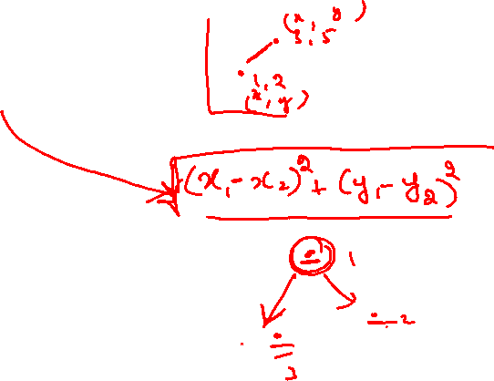
Member functions (Other functions)
class Point {
int x;
int y;
float calculateDistance(Point &p) const;
public:
//getters
int getX();
int getY();
Point getPoint();
//setters
void setX(int x);
void setY(int y);
void setPoint(int x, int y);
void setPoint(Point p);
//Other functions //Accessors
void printPoint() const;
Point find_closest (Point &p1, Point &p2) const;
};

Slide 24
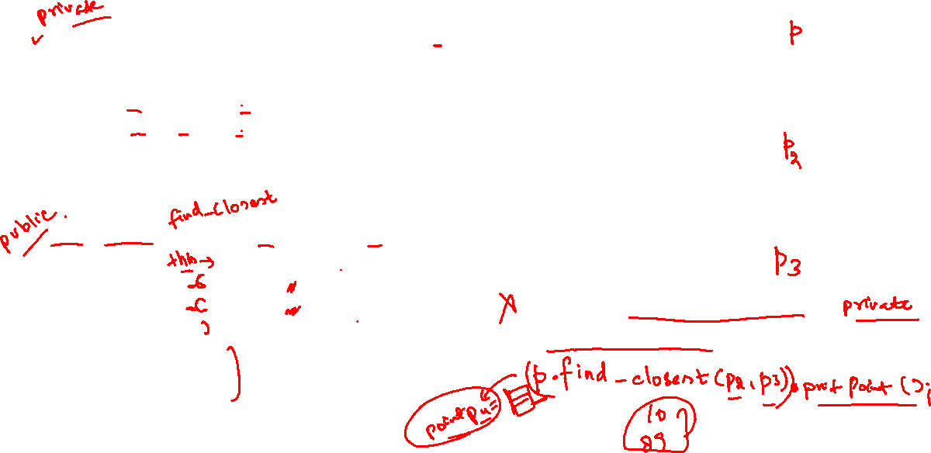
Member functions (Other functions)
void main(){
Point p; p.setPoint(5,8);
p.printPoint();
Point p2;
p2.setPoint(100,85);
p2.printPoint();
Point p3;
p3.setPoint(10,89);
p3.printPoint();
cout<< p.calculateDistance(p2);
p.calculateDistance(p2,p3).printPoint();
}
X
y
float Point::calculateDistance(Point &p) const
{
int d1 = p.x - x;
int d2 = p.y - y;
float temp = ( (d1*d1) + (d2*d2) );
return sqrt(temp);
}
Point Point::(Point &p1, Point &p2)const
{
float d1 = Calculate_Distance(p1);
float d2 = Calculate_Distance(p2);
if(d1<=d2)
return p1;
else
return p2;
}
5
8
X
y
100
85
X
y
10
89

